Slide 1
Computer Vision
Industrial IoT
Software and Services Group
IoT Developer Relations, Intel

Slide 4
What is the Intel® CV SDK?
The Intel® Computer Vision SDK is a new software development package for development and optimization of computer vision and image processing pipelines for Intel System-on-Chips (SoCs).
Intel-optimized implementation of the Khronos OpenVX 1.1 API
Pre-built and fully-validated community OpenCV 3.3 binaries
Vision Algorithm Designer (VAD)
Deep Learning Model Optimizer tool
Deep Learning Inference Engine
Notes:
Intel® Computer Vision SDK
The Intel® Computer Vision SDK is a new software development package for development and optimization of computer vision and image processing pipelines for Intel System-on-Chips (SoCs).
The product includes six major components:
Intel-optimized implementation of the Khronos OpenVX 1.1 API**, extended with both additional API (see the Intel’s Extensions to the OpenVX* API: OpenCL™ Custom Kernels and Intel’s Extensions to the OpenVX* API: Advanced Tiling chapters) and kernels, including support for Convolutional Neural Networks (CNN), (see the Intel’s Extensions to the OpenVX* Primitives chapter).
Pre-built and fully-validated community OpenCV 3.3 binaries with additional fast and accurate Face capabilities, described in the chapter Advanced Face Capabilities in Intel’s OpenCV.
Vision Algorithm Designer (VAD), a cross platform IDE tool, for visual development and analysis of OpenVX* graphs. For details, refer to the VAD Developer Guide.
Deep Learning Model Optimizer tool to help you with deploying Convolutional Neural Networks. For details, refer to the Deep Learning Model Optimizer Developer Guide.
Deep Learning Inference Engine that features unified (OpenVX-agnostic) API to integrate the inference with application logic. For details, refer to the Deep Learning Inference Engine Developer Guide.
Sample applications (available as a separate package). For details, see the Intel® Computer Vision SDK Sample Applications topic.

Slide 5
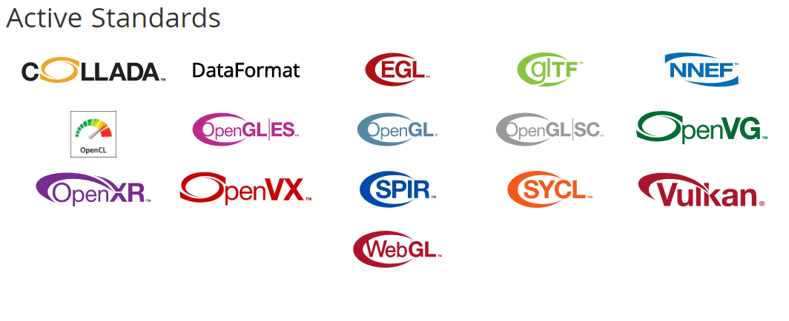

Slide 6
What is OpenVX*?
OpenVX* is about standardized, portable, power-efficient vision processing.
Faster development of computer vision applications
Better optimization via directed graph scheduling of image kernels/algorithms. Each graph node can run on a separate piece of hardware.
OpenVX chooses which hardware to run each step of your computer vision graph (e.g. CPU, GPU, VPU).
Smaller number of algorithms than OpenCV. However, Khronos maintains a conformance test suite that can validate a vendors OpenVX implementation.
FN1
OpenVX Nodes
Camera Input
Image Output
Color Conversion
Extract Channel
Image Pyramid
Optical Flow
Harris Corners
FN2
OpenVX Graph (Video Pipeline)

Slide 7
Algorithms in OpenVX* 1.1
Absolute Difference
Accumulate
Accumulate Squared
Accumulate Weighted
Arithmetic Addition
Arithmetic Subtraction
Bitwise And
Bitwise OR
Box Filter
Canny Edge Detector
Channel Combine
Channel Extract
Color Covert
Convert bit depth
Custom Convolution
Dilate Image
Equalize Histogram
Erode Image
Fast Corners
Gaussian Filter
Harris Corners
Histogram
Image Pyramid
Integral Image
Magnitude
Mean and Standard Deviation
Media Filter
Min Location
Max Location
Optical Flow Pyramid
Phase
Pixel-wise Mulitplication
Remap
Scale Image
Sobel 3x3
TableLookup
Thresholding
Warp Affine
Warp Perspective

Slide 8
OpenVx* Vs. OpenCV*
 | OpenCV* | OpenVX*
Implementation | Community driven open source library | Open standard API designed to be implemented by hardware vendors
Conformance | Extensive OpenCV Test Suite but no formal Adopters program | Implementations must pass defined conformance test suite to use trademark
Consistency | Available functions can vary depending on implementation / platform | All core functions must be available in all conformant implementations
Scope | Very wide 1000s of imaging and vision functions Multiple camera APIs/interfaces | Tight focus on core hardware accelerated functions for mobile vision – but extensible Uses external/native camera API
Efficiency | Memory-based architecture Each operation reads and writes to memory | Graph-based execution Optimizable computation and data transfer
Typical Use Case | Rapid experimentation and prototyping - especially on desktop | Production development & deployment on mobile and embedded devices
Embedded Deployment | Re-usable code | Callable library

Slide 9
OpenCV*
# python code snippets go here
Open Source library for computer vision
Written in C++
Bindings for most popular languages
Block-like programming structure
Image data is sequentially passed through functions
Fundamental concepts allow for powerful image processing tools
import cv2
import numpy as np
codingbox.com
Notes:
This is a broader overview; want to show what blocks are and how they fit in together

Slide 10
Computer Vision Algorithms

Slide 11
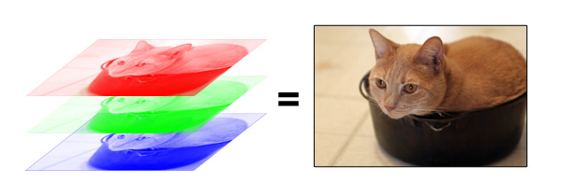
Image Binary Representation
uint8
arrays
Cadin Batrack
img = cv2.imread( ‘image.jpg’) # open image
cv2.imshow( ‘Title’, img ) # show image
cv2.imwrite( ‘image2.jpg’, img ) # write image file
Notes:
Images are simply 3-channel numpy BGR arrays
Take on value 0-255

Slide 12
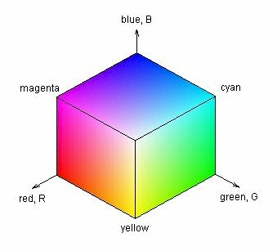
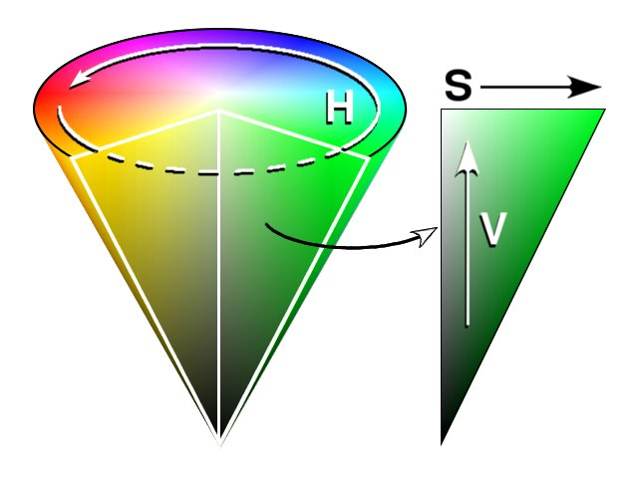
Colorspaces
$$\left(Blue, Red, Green\right)↔\left(Hue, Saturation, Value\right)→(Intensity)$$
BGR | HSV | Grayscale
intensity
img2 = cv2.cvtColor( img, cv2.COLOR_BGR2HSV )
Notes:
Grayscale is useful for assigning function $f\left(x, y\right)$to every pixel
Eg for calculating distance between 2 images’ pixels
Eg for probability that an object centered at that location matches a template
HSV more intuitive than BGR; can be used to find define colors more easily (as long as Hue values known :D )

Slide 13
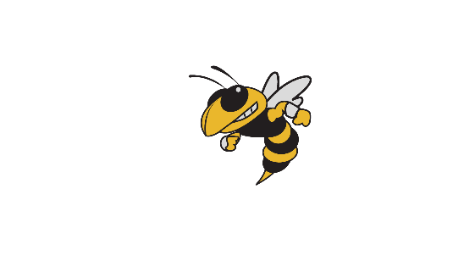
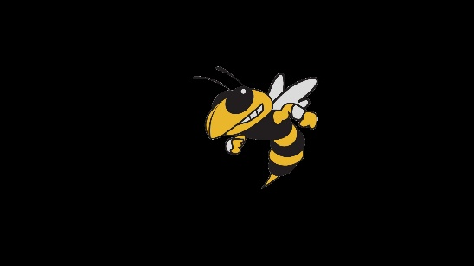
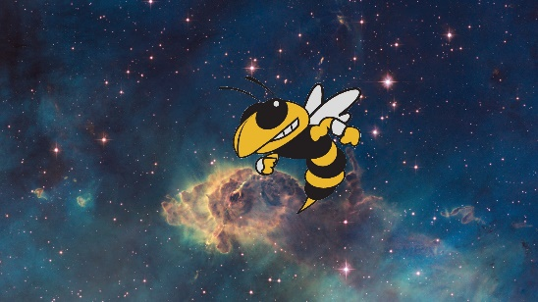
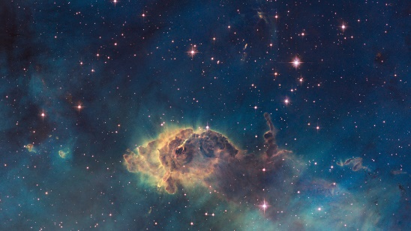
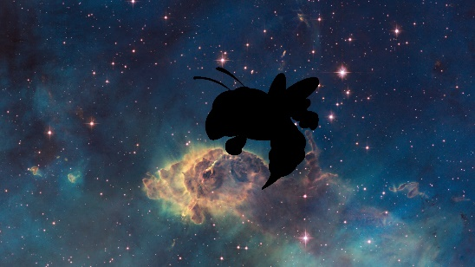
Masking
ret, thresh = cv2.threshold( single_channel, min_value , set_value_to, cv2.THRESH_BINARY )
mask = cv2.inRange( hsv_img, lower_color , higher_color )
cv2.bitwise_and( img, img, mask = mask )
Combine
Image
+
Mask
inRange
threshold
Image
Mask
Binary
operations
Notes:
Use range and thresholding to create logical masks of images
The masks allow regions of different images to be combined together
Binary nature allows for extracting and analyzing shapes from images

Slide 14
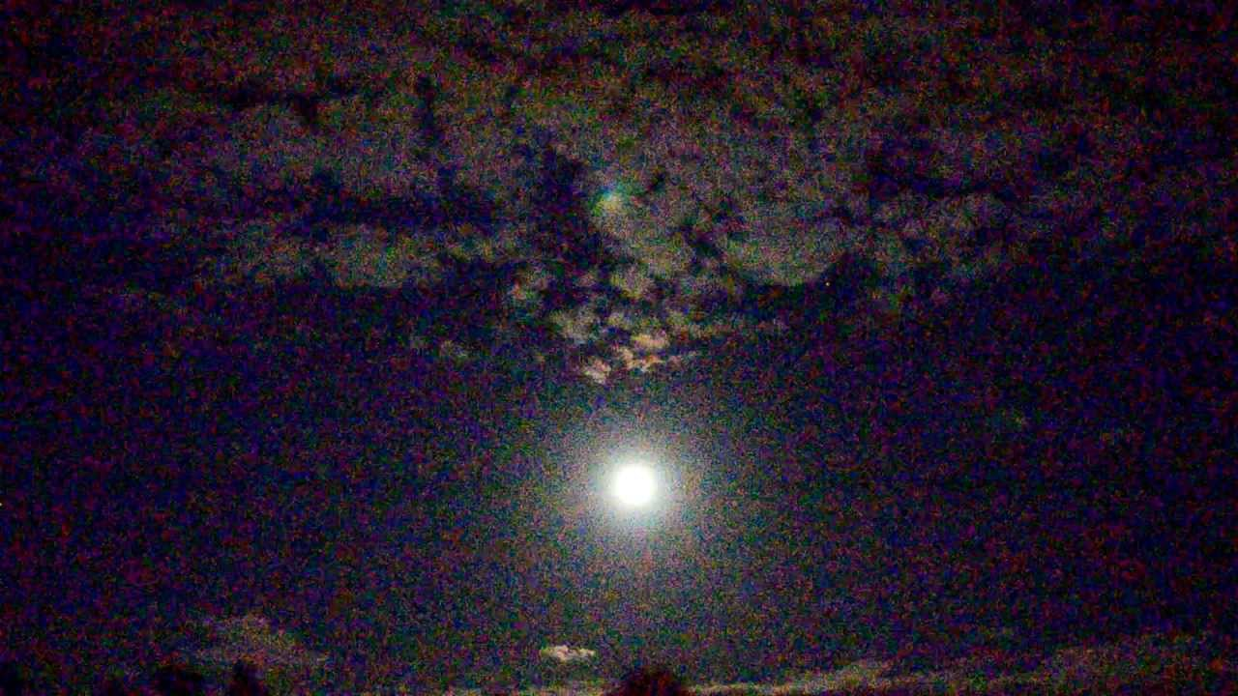
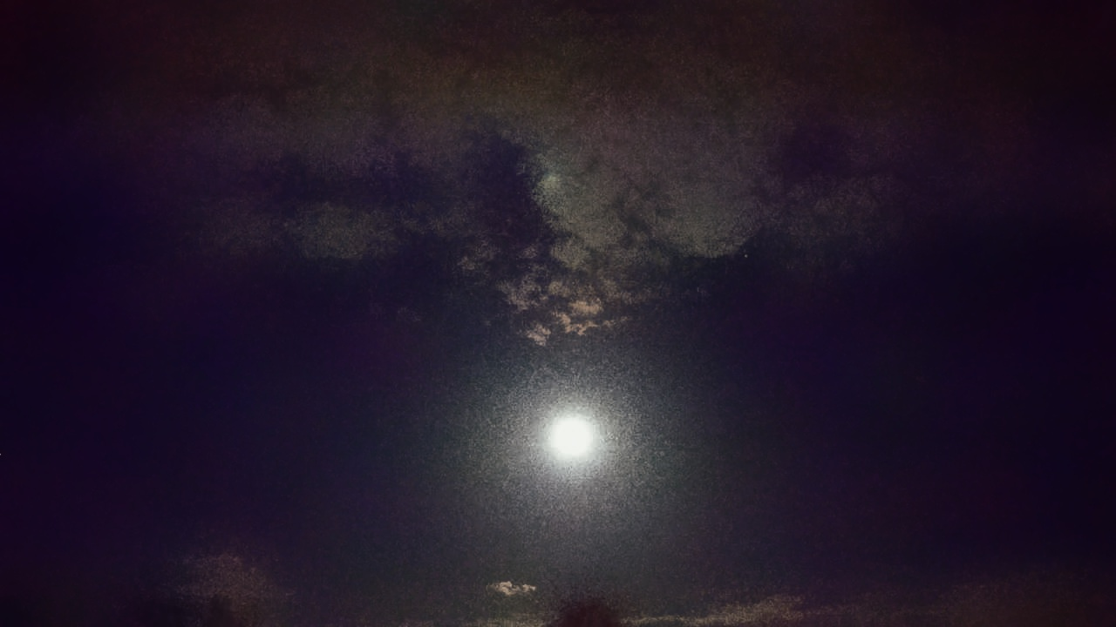
Filtering
Noise Removal (LPF)
Sharpness increase (HPF)
Operate on Kernel

Slide 15
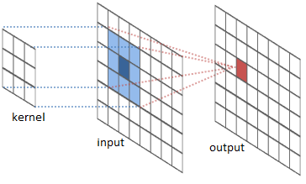
Filtering: Smoothing
Uses 2D Convolution
Blurring removes noise
Kernel size determines blur amount
Types:
Mean - average
Median – less prone to outliers
Gaussian – applies Gaussian curve
Bilateral – blurs & preserves edges
# 5x5 mean filter
kernel = np.ones( ( 5, 5 ) , np.float32 ) / 25
res = cv2.filter2D( img, -1, kernel )
Notes:
Bilateral – applies both a Gaussian and a Gradient to curve
Allows it to both blur and preserve edges
More costly

Slide 16
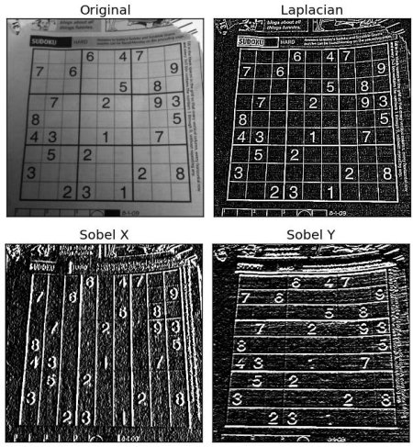
Filtering: Gradients
High Pass Filters
Used to find edges in an image
Specify Kernel size
Types:
Sobel – directional derivatives
Scharr – better for smaller kernel
Laplacian – relation on Sobel derivatives
laplace = cv2.Laplacian( img, cv2.CV_64F )
sobelX = cv2.Sobel( img, cv2.CV_64F, 0, 1, ksize = 5 )
OpenCV Documentation
Notes:
Useful for detecting edges of image

Slide 17
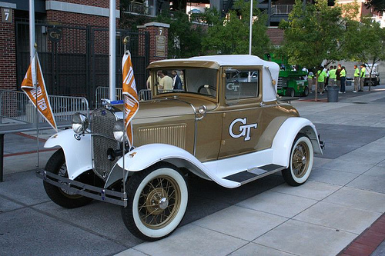
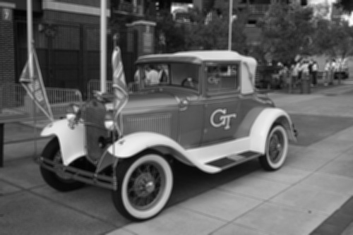
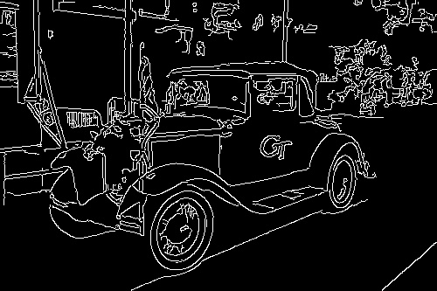
Gradients for Canny Edge Detection
# 4x4 mean filter
kernel = np.ones( ( 4, 4 ) , np.float32 ) / 16
wreck= cv2.filter2D( img, -1, kernel )
# apply canny edge detection
edges = cv2.Canny( wreck, 0, 200 )
Original
Smoothed
Canny
Notes:
more elaborate algorithm to find edges of object
gives a binary mask of edges
issue: want to do computations on objects in image
BUT this is only a map of pixels; the edges don’t have to form closed object
similar to contrasting surface (frontier) with manifold boundary in Calc III
one is just a set of points; the other is a mathematical object (representation)
that can be operated on

Slide 18
Filtering: Morphological Transformations
kernel = np.ones( ( 5, 5 ) , np.float32 ) / 25
erosion = cv2.erode( img, kernel, iterations = 1 )
dilation = cv2.dilate( img, kernel, iterations = 1 )
opening = cv2.morphologyEx( img, cv2.MORPH_OPEN, kernel )
closing = cv2.morphologyEx( img, cv2.MORPH_CLOSE, kernel )
Original
Erosion
Combination
Noisy Image
Dilation
Notes:
Fundamental Transformations:
Erosion – if all neighbors = 1, lives; dies otw
Dilation – if any neighbor = 1, lives; if none on, dies
Combine for better results
Open – Erode, then Dilate
Close – Dilate, then Erode
Use for noise removal and connecting/disconnecting shapes
relate binary maps: masks + edges + morph transf

Slide 19
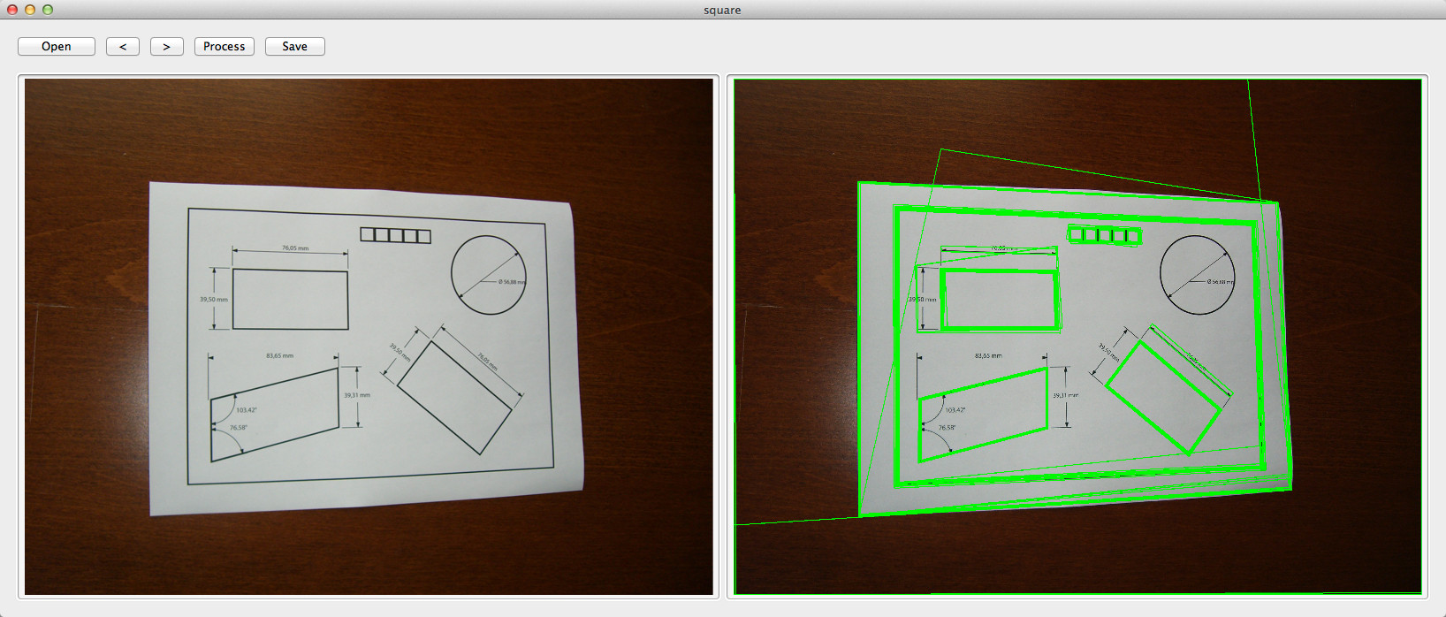
Contours
Join all continuous points along boundary
Detect from logical mask
Contour hierarchies allow selection of a contour based on its relation to others
img2, contours, hierarchy = cv2.findContours( mask, cv2.RETR_TREE, cv2.CHAIN_APPROX_SIMPLE )
cv2.drawContours( img, contours, contour_number, ( 0, 255, 0 ), thickness )

Slide 20
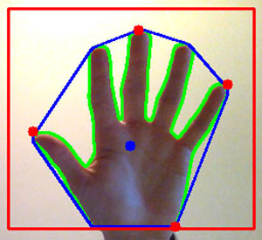
Contour Functions
Contours can be mathematically analyzed
OpenCV functions give:
Moments & Centroids
Area & Perimeter
Convex hulls
Bounding Rectangles
Fit curves & shapes
Outermost points
Shape Matching

Slide 21
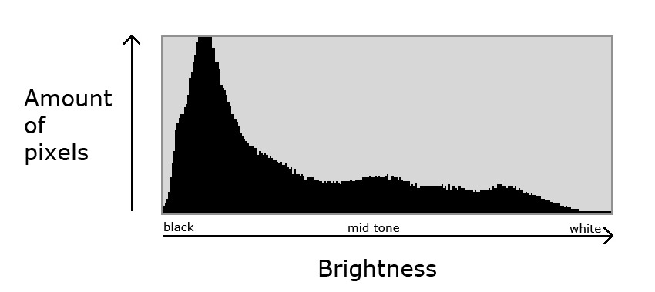
Histogram: $intensity→frequency$
juzaphoto
hist = cv2.calcHist( [img], [channel], mask, [number_bins], [min_val, max_val] )
Notes:
Histograms plot color intensity vs frequency
Are a powerful tool for optimizing and tracking colors in CV
--
relate pixel to entire image
allow us to look at image on broader terms

Slide 22
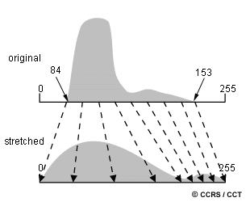
Histogram Equalization
Notes:
Calculate probability of pixels in peak range, redistribute throughout whole range

Slide 23
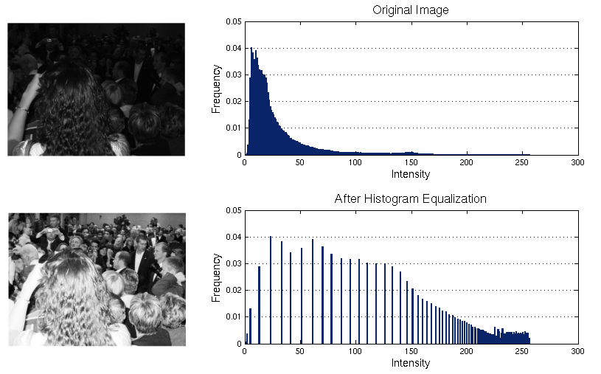
eq = cv2.equalizeHist( img )
James Fishbaugh
Notes:
Effective for improving contrast of image
Works best on single-peak/single-range images

Slide 24
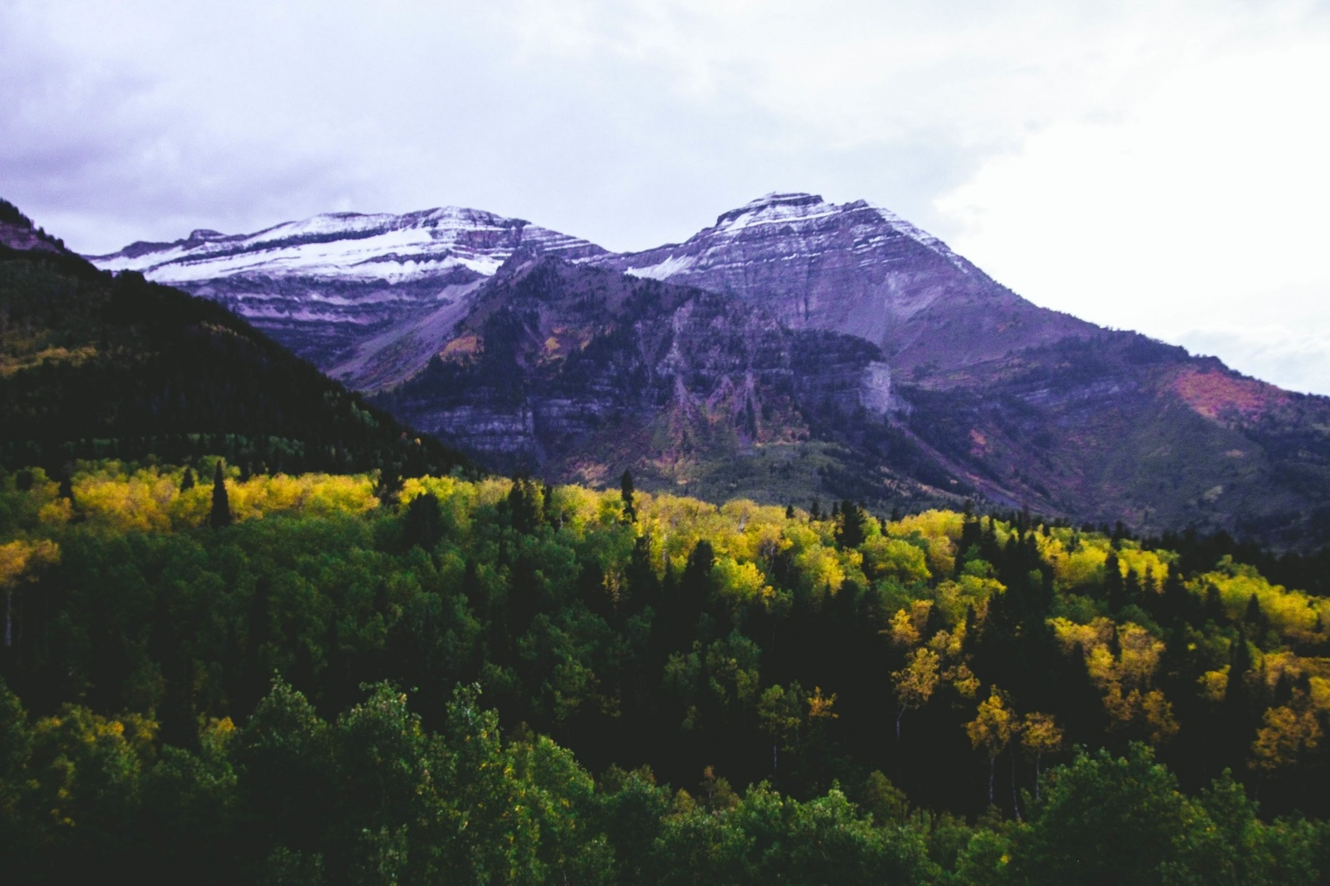
2D Histogram: $(hue, saturation)→frequency$
Hue
frequency
Saturation
hist = cv2.calcHist( [img], [0, 1], mask, [180, 256], [0, 180, 0, 256] )
Notes:
explain, piggybacking off of HSV slide

Slide 25
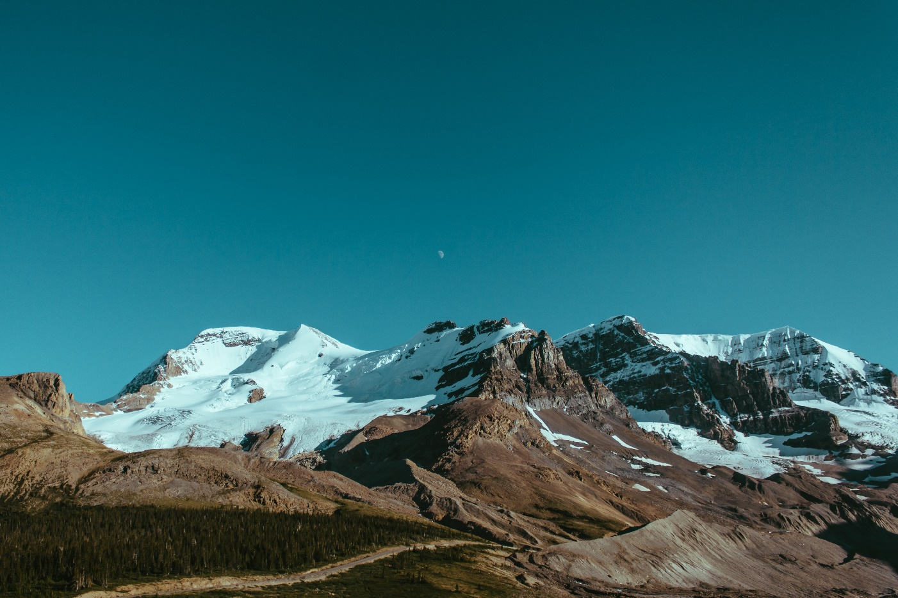
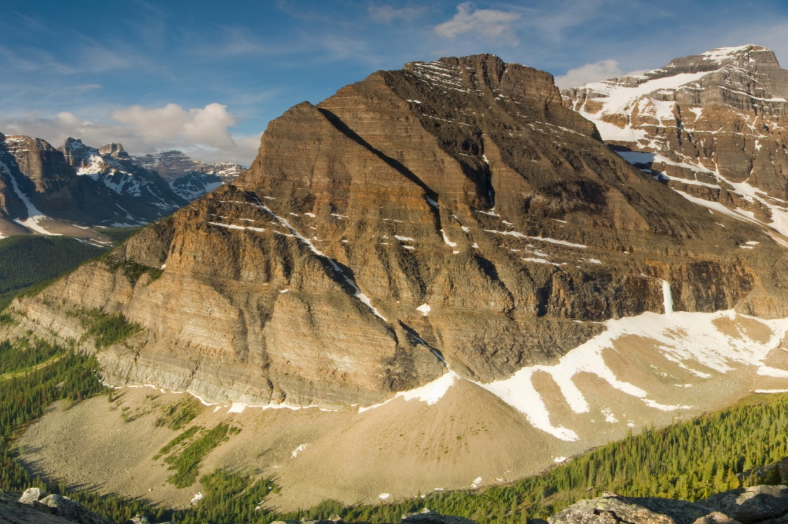
Histogram Backprojection
Returns similarity of pixels in image region to the histogram
Useful for object detection
Find similar mountains
Example of a mountain

Slide 26
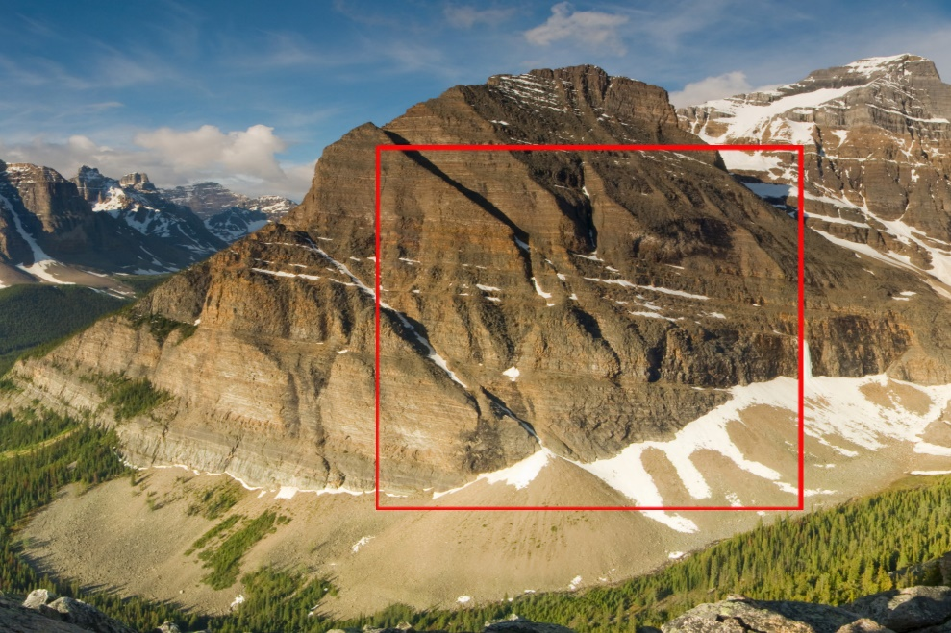
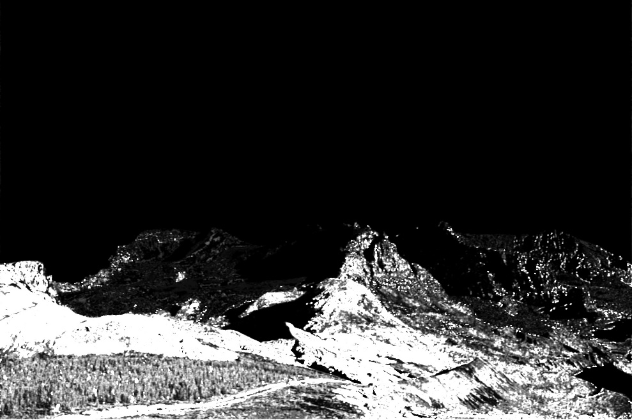
Calculate
region histogram
Select region
create into mask
Back project
Distance
mapping
Notes:
ex. drone can analyze video on the fly

Slide 27
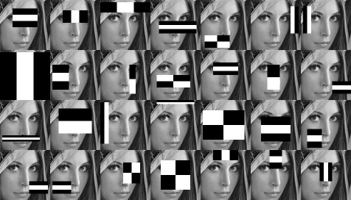
Haar Cascades & Classifiers
Notes:
First, machine learning techniques are used to train the classifiers from a dataset
Commonly used cascades available with OpenCV library
Then, a cascades technique rapidly analyzes an image
Essentially, takes points with a classifier and discards all without it
Yields points pertaining to classifiers
Useful in face and object detection etc.

Slide 28
cascade = cv2.CascadeClassifier( ‘haarcascade_frontalface_default.xml’ )
gray_img = cv2.cvtColor( img, cv2.COLOR_BGR2GRAY )
faces = cascade.detectMultiScale(
gray_img,
scaleFactor = 1.25,
minNeighbors = 5,
minSize = ( 30, 30 ),
)
for (x, y, w, h) in faces:
cv2.rectangle( img, x, y, (x+w, y+h), (0, 255, 0), 2)

Slide 29
Computer Vision Graph Examples

Slide 30
Crosshair follows object of distinct color
Set
Mouse
callbacks
Color
Range
Trackbars
Capture
Video from
Webcam
Convert frame to HSV
Mask colors in range
Morph. close mask to fill holes
Find contours
Find largest contour
Find centroid
Draw crosshair on centroid

Slide 31
Modularity: using an online video stream
Video capture from online webcam
Load video URL
Start stream
Do whatever processing is necessary
Parse stream
Decode to frame
Notes:
Frame-based analysis of video allows us to generate our own video streams
The while loop going over each frame allows us to utilize the frames from these streams

Slide 32
Presence detection from an online camera
Click to capture empty room
Capture online
video
Generate frame buffer
Take image of empty room
Take distance between current and empty pixels
Take threshold of distances
Dilate map to close holes
Find contours
Find contour of largest area
Update buffer
If buffer is full, draw contours
Display video

Slide 33
Storing video upon face detection
Capture
Video from
Webcam
Generate buffer
Create cascade classifier from Haar Cascade
Convert color to grayscale
Generate video writer
Create face detection cascade
Draw rectangle around faces
Wait until buffer ends
Video saved to file

