Slide 1

Protocols
Industrial IoT
Software and Services Group
IoT Developer Relations, Intel

Slide 2

IIoT Connectivity Challenge
The goal of the industrial internet is to enable seamless information sharing across domains and industries.
Past capital investments in equipment have create a myriad of domain specific connectivity technologies, tightly vertically integrated and optimized to solve domain specific needs.
IIoT systems usually integrate with brownfield technologies to preserve the capital investments, and greenfield technologies to spur innovation.
Notes:
IIoT Connectivity Challenge
The goal of the industrial internet is to enable seamless information sharing across domains and industries.
Past capital investments in equipment have create a myriad of domain specific connectivity technologies, tightly vertically integrated and optimized to solve domain specific needs.
IIoT systems usually integrate with brownfield technologies to preserve the capital investments, and greenfield technologies to spur innovation.

Slide 3

Notes:
To give simple example of a brownfield installation here is a typical, American, gas meter, the type that you might find on any home.
This household gas meter demonstrates a simple brownfield installation. The gas meter, valves and piping have been installed for a long time, but a new addition to the front of the system adds a radio to the system. The gas company can drive around in a van with the gateway system. The gateway receives the gas consumption numbers from the sensor and they are collected for the gas company’s business statistics and billing.
Let’s talk about how both brownfield and greenfield system can be architected to scale.

Slide 4

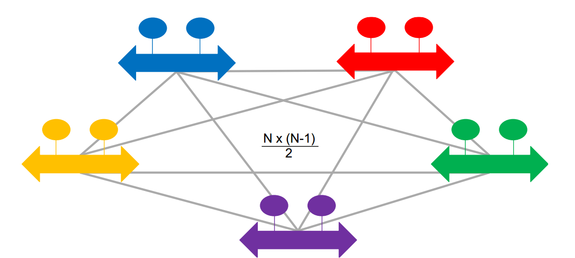
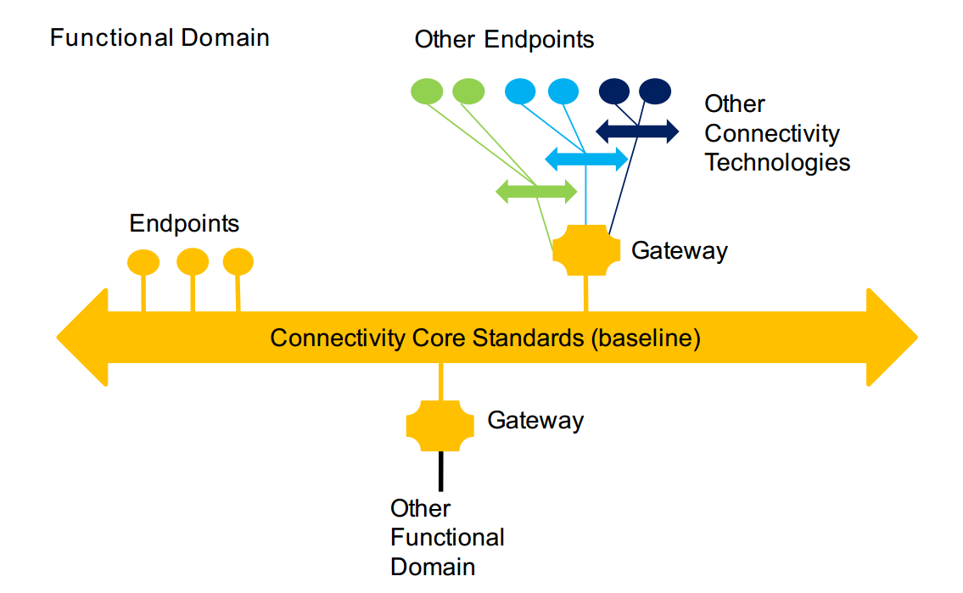
Scalability Model Needs Domain Gateways
Complete connectivity rapidly becomes unmanageable.
To keep the connectivity architecture manageable, a connectivity technology standard is chosen as the baseline within a functional domain, and referred to as the “connectivity core standard”
To facilitate information exchange, one has to build bridges to each of the other connectivity technologies.
Notes:
IIoT Connectivity Reference Architecture
The Industrial Internet of Things requires us to think about scale and interoperability. Both the number of installed communicating devices and the number of communication types.
In this talk we will introduce an IIoT Connectivity Reference Architecture that achieves near linear scalability, O(N), with respect to the number of connectivity technologies. This is important from the our four main viewpoints. From the business viewpoint implementing scalable systems will decrease capital expenditure. From a Usages and Functional view points it increases the maximum size potential devices that can be connected. We will mainly focus on the implementation viewpoint by first introducing the idea of a mutli-bus, multi-protocol network system. Then we will discuss some of the commonly used protocols that used in IIoT deployments.
First, let’s consider a fully connected graph of IoT sensor devices. Fully connected in this case doesn’t just mean that there is a network connection between two endpoints, but that there is data and protocol compatibility.
To keep the connectivity architecture manageable, a connectivity technology standard is chosen as the baseline within a functional domain, and referred to as the “connectivity core standard” (see Figure 3-2). Gateways are used to bridge other connectivity technologies within the domain and to the connectivity core standards used in other functional domains. Connectivity between functional domains, often implemented in a tiered manner, can be intermittent. Connectivity gateways can help mitigate this intermittent connectivity. Applications are simpler and easier to maintain if logic is not needed to react to failed data exchanges.
Some endpoints can connect directly to a core standard. Other endpoints and subsystems connect through gateways. A core standard then connects them all together, allowing multiple connectivity technologies to be integrated without having to bridge between all possible pairs, so avoiding the dreaded N-squared bridging problem (see Figure 3-1). Each domain-specific connectivity technology needs only a gateway to just one connectivity core standard.
Connectivity gateways enable incorporation of new connectivity technologies. They provide a stable foundation anchored in the “best-of-breed” technologies available today, yet can pivot in the future to a new baseline core standard that better satisfies the requirements.
It accomplishes this by defining a small set of connectivity core standards. Standardized core gateways bridge the connectivity core standards. Domain-specific connectivity technologies need a gateway to just one of the connectivity core standards, to participate in an information exchange with the rest of the IIoT ecosystem.
The first diagram shows the challenge of building applications that require information exchange across different connectivity technologies. To facilitate information exchange, one has to build bridges to each of the other connectivity technologies. Given N connectivity technologies, this requires building N*(N-1)/ 2 = O(N²) bridges. That quickly becomes impractical for large N (> 3 or 4). The result is information silos, making it impossible to realize the vision of the Industrial Internet to create new value stream from heretofore locked up information flows.
Using a gateway to a core connectivity standard, a domain-specific endpoint can communicate with endpoints on other domain-specific technologies also connected via gateways to the core connectivity standard (see Figure 3-2). Core connectivity endpoints can directly communicate with each other, and via gateways with domain-specific connectivity endpoints. Different functional domains may have different choices of core connectivity standards, due to different priorities on technical requirements, tradeoffs and ecosystems. To enable communication between different connectivity core standards, standardized gateways are needed. A standardized gateway between core connectivity standards is referred to as a core gateway. It allows domain-specific endpoints connected to one core standard to communicate with domain-specific endpoints integrated over another core standard, as shown in Figure 3-3.
Also, it allows endpoints on the two core connectivity standards to interoperate.

Slide 5
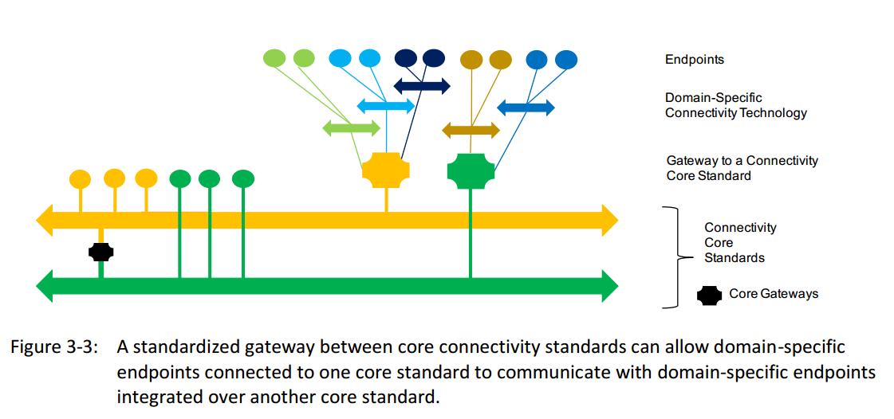
Bridging Core Connectivity Standards
Notes:
Let K be the number of core standards. Then the number of core gateways that will be
standardized is K * (K - 1) / 2, as shown in Figure 3-4. If N is the total number of connectivity
technologies (see Figure 3-1), then only additional (N-K) gateways are needed with the
introduction of core standards. The total number of gateways required becomes
K*(K-1)/2 + (N-K) vs. the original N*(N-1)/2 shown in Figure 3-1. Assuming K << N, the number of gateways goes
from O(N²) to O(N), which is much more tractable.
Each additional core standard creates increasing complexity and interoperability challenges with
the square of the number of core standards. A few (small K) core connectivity standards should
suffice to cover the needs of IIoT systems across the functional domains and industries to attain
the goal of horizontal interoperability.

Slide 6
Tools: Protocol Assessment template
Core Standard Criterion | Protocol Checklist
Provide syntactic interoperability | √
Open standard with strong independent, international governance | X
Horizontal in its applicability across industries
Stable and deployed across multiple vertical industries
Have standards-defined Core Gateways to all other core connectivity standards
Meets connectivity functional requirements
Meet non-functional requirements of performance, scalability, reliability, resilience
Meet security and safety requirements
Not require any single component from any single vendor
Have readily-available SDKs both commercial and open source
The assessment template is intended to be a tool for understanding any connectivity technology
in the context of the IIoT needs.
The worksheet is helpful for:
understanding how a connectivity technology supports specific IIoT functional needs,
evaluating a connectivity technology’s trades-offs for typical IIoT considerations and
determining a connectivity technology’s suitability for a particular use case (once the
specific requirements are understood).

Slide 7
Connectivity Framework Core Functions
Data Resource Model – represents structured data objects that can change state over time
ID and Addressing – provides the means to identify and address each data object
Data Type System – provides a way to describe the constrains place on data, includes a method of evolving and versioning the data syntax
Publish/Subscribe – supports the well-know pubsub pattern for decoupled data exchange
Request/Reply - supports the well-know request/reply pattern for data exchange
Discovery – must be able to find pubsub services, request/reply services, endpoints and datatypes.
Exception Handling – mechanisms for handling disconnections, changes in configuration or quality, endpoint failures, etc…
Data Quality of Service – QoS method implemented, best-effort vs. reliable delivery
Data Security – confidentiality, integrity, authenticity and non-repudiation of the data
Data Governance – is there a standards body that directs this protocol’s evolution

Slide 8
Data Type Systems
A connectivity framework provides a data type system representing data objects as structures in a programming environment
formatting data to be communicated on the wire
provide a means of managing the evolution of data types
defines the serialized data format in communication (in motion) and
in storage (at rest)
a connectivity framework should provide a means to manage the lifecycle of a data object.
State Management for Data Types
Publish / Subscribe
Request / Reply
Notes:
4.1.1 DATA RESOURCE MODEL
Connectivity frameworks provide a way of representing data objects1 that can change state over
time. A data-object is a structured collection of fields, as in a programming language. It may be
hierarchical and may be statically or dynamically typed.
A connectivity framework distributes changes to data-object amongst the participants.
Data models for different application areas or industries are usually mapped into the abstract
data-objects provided by a connectivity framework.
To ensure syntactic interoperability, a connectivity stack (see section 2.1) will provide a way to
describe the data syntax. A data type is a syntactic constraint placed upon the interpretation of
data. It is not possible to connect systems without sharing or mapping data types, either implicitly
(e.g. in code) or explicitly.
A connectivity framework provides a data type system for representing data objects as structures
in a programming environment and for formatting data to be communicated on the wire. The
data type system may be object-oriented, like the data types found in statically-typed
programming languages (e.g. C, C++, C# or Java), or object-based like the dynamic data types
found in dynamically-typed programming languages (e.g. JavaScript, Python, Lua).
The data type system should provide a means of managing the evolution of data types. This
includes versioning and assignability rules across versions, so that applications using newer
versions of a data type can communicate with applications using older versions of a data type to
the maximum extent possible.
The data type system also defines the serialized data format in communication (in motion) and
in storage (at rest), and operations to serialize from a programming language representation into
the serialized format, and to de-serialize back into the programming language representation.
DATA RESOURCE LIFECYCLE (CRUD)
A connectivity framework should provide a means to manage the lifecycle of a data object. These
include the following four critical operations, abbreviated as “CRUD”:
• create (C): a means of creating or introducing a new data object,
• read (R): a means of observing the state of a data object,
• update (U): a means of updating the state of a data object and
• delete (D): a means of deleting a data object.
STATE MANAGEMENT
IIoT components need access to high frequency, high-volume data beyond when it was initially
produced. For example, a component may require the last n updates to plan the next action or
make a prediction.
A connectivity frameworks can manage the historical state of the data objects. They can cache
the last n updates to a data object so that applications can simply examine the historical state.
Connectivity frameworks can get the current state, even though the state may have changed long
before a participant joined the system or reconnected. It may maintain a virtual view of the data
objects associated with an endpoint and synchronize it when a connection is re-established.
PUBLISH-SUBSCRIBE
A connectivity framework should support the publish-subscribe data-exchange pattern in which
a component publishes data on a well-known topic without regard to subscribers, and a
component subscribes to data from the well-known topic without regards to publishers. This
decouples publishers from subscribers, using only the channel for the topic at hand, so that
components are loosely coupled and can be replaced independently of one another. An endpoint
may operate in both a publisher and subscriber role. This data exchange pattern is also called the
push data-exchange pattern.
The publish-subscribe data exchange pattern is useful for one-to-many and many-to-many data
distribution scenarios, including streaming, alarms and events, command and control, and
configuration (Industrial Internet Reference Architecture, IIRA)1.
The decoupling in space (location) and time (asynchronous delivery) provided by publishsubscribe data exchange pattern achieves the reliability, performance and scale demanded by
IIoT systems. It also decreases the likelihood of fault propagation and simplifies incremental
updating and evolution.
REQUEST-REPLY
A connectivity framework for IIoT should support the request-reply data exchange pattern. This
data exchange pattern uses requestors that can initiate a service request to be fulfilled by
endpoints in the replier role. An endpoint may operate in both a requestor and a replier role. This
pattern is also called a pull or request-response data exchange pattern.
The request-reply data exchange pattern is useful when working with a sparse subset of large
data—for example to query specific data objects or invoke specific services.
The request-reply data exchange pattern permits synchronous or asynchronous exchange of data
between endpoints. In synchronous request-reply, a requestor waits for the replies before issuing
the next request. In asynchronous request-reply, a requestor can have multiple outstanding
requests and replies are processed as they are received.

Slide 9
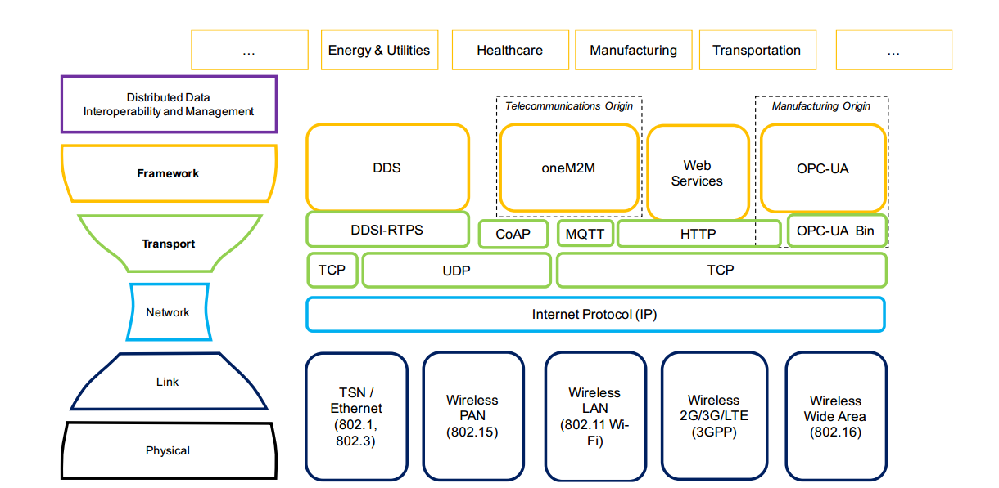
IIoT CONNECTIVITY STACK MODEL
Industry
Energy Sector
Health Care
Transportation
Manufacturing
Transport
DDS
Web Services
OPC-UA
Network
TCP
CoAP
MQTT
HTTP
OPC-UAB
TCP
UDP
TCP
Link
IP Protocol
TSN / Ethernet
Wireless PAN
Wireless LAN
Wireless 2G/3G/LTE
Wireless Wide Area
Physical
Notes:
The lowest layer is the physical layer, which refers to the exchange of physical signals (electric,
optical, or other) on the physical media (wired or wireless) connecting the participants. Above it
is the link layer, which refers to the exchange of frames using signaling protocols on the shared
physical link between adjacent participants. Above it is the network layer, which refers to the
exchange of packets (bounded length), possibly routing them over multiple links to communicate
between non-adjacent (remote) participants. Above it is the transport layer, which refers to the
exchange of messages (variable length) between participant applications. Above it is the
framework layer, which refers to the exchange of structured data (state, events, streams) with
configurable quality-of-service between participant applications. Above it, but outside the scope
of connectivity, is the distributed data interoperability and management layer crosscutting
function that relies on the data sharing mechanism provided by the connectivity framework layer.
Performance
Latency and jitter. Latency is the time it takes for data to go from source to destination (“time of
flight”). Jitter is the variation in latency. The data usually has a limited useful lifetime, so low
latency is essential. Low jitter is also needed to ensure the application has integrity and system
maintains predictable performance. The connectivity function addresses latency and jitter in the
data exchanged between endpoints, possibly in exchange for throughput.
Throughput. Throughput is the load on the network as defined by the volume of data flow per
unit of time. Bandwidth is the network capacity of a connectivity technology. In some designs, a
large volume of data may be exchanged in a short time on an ongoing basis among endpoints;
high throughput would be needed.
In practice, the operational settings that optimize for high throughput are not the same as those
that optimize for low latency. Therefore, the connectivity function should support achieving the
right balance as per the requirements of the data flow.
In industrial internet applications, particularly at the edge, low latency and jitter are generally
more important to performance than throughput and bandwidth. Automation and control of
real-world processes require short reaction times or tight coordination to maintain effective
control. Industrial devices in the control domain do not produce large amounts of data in short
periods and therefore do not require high bandwidth connectivity. Rather, the data needs to be
communicated quickly and consistently (with low latency and jitter).
Resilience
Because many IIoT systems will operate continually in a real-world environment, the connectivity
function should be available (in the logical view), even when there is a temporary physical
disconnection. When a broken connection is restored, data exchange should be automatically
restored so that the latest updates are available to the consumers along with any relevant missed
updates.
The connectivity function should support graceful failure or disconnection of endpoints, by, for
example, confining the loss of data exchange only to disconnected endpoints.
Longevity - Connectivity components, especially those in the network layer and below, are built into the
hardware and hence are not easily replaceable. Where possible and feasible, the connectivity
software components should support incremental evolution including upgrades, addition and
removal of components. The connectivity function should also be able to support incremental
evolution of the data exchange solutions during the lifecycle of a system.
Integration and Interoperability
IIoT systems comprise components that are often systems in their own right. The connectivity
function should support the integration and the interoperability of system components, isolation
and encapsulation of data exchanges internal to a system component, and hierarchical
organization of data exchanges. In dynamic systems, the connectivity function should also
support discovery of system components and the discovery of relevant data exchanges for
system composition.
Operation
IIoT systems generally operate non-stop in a real-world environment. To support a system’s
operational needs, it should be possible to monitor, manage and dynamically replace
connectivity elements. Monitoring includes health, performance and service-level characteristics
of the connectivity function; management includes configuring and administering the
capabilities; dynamic replacement requires replacement of hardware and or software while a
system is operating
SAFETY
A high degree of assurance is required in life- and mission-critical systems1 to avoid unintended
consequences during system operation. The connectivity function should be able to support
safety evaluations and provide evidence required to make informed safety assessments.
CONNECTIVITY FRAMEWORK LAYER
The connectivity framework layer provides a logical data exchange service to the endpoints
participating in an information exchange. It can observe and “understand” the data exchanges,
and use that knowledge to optimize data delivery. It is a logical functional layer on top of the
connectivity transport layer (see Figure 2-1) and should be agnostic to the technologies used to
implement connectivity transports.
The key role of the connectivity framework layer is to provide syntactic interoperability among
the endpoints. Data that is exchanged is structured in a common, unambiguous data format,
independent of endpoint implementation, and decoupled from the hardware and programming
platform. Depending on the application logic behind endpoint, one or more data exchange
patterns may be required. There are two predominant data exchange pattern styles: publishsubscribe (see section 4.1.6) and request-reply (see section 4.1.7).
A key benefit of the connectivity framework is to abstract and hide the implementation of the
various functions so that the applications that use the connectivity framework won’t need to
know the implementation, just use its capabilities. It reduces the cost of development and
increases productivity and quality.

Slide 10
Data Distribution Service (DDS)
Data Writer
Data Reader
The Data Distribution Service for real-time systems (DDS) is an Object Management Group (OMG) machine-to-machine(sometimes called middleware) standard that aims to enable scalable, real-time, dependable, high-performance and interoperable data exchanges using a publish–subscribe pattern. DDS addresses the needs of applications like financial trading, air-traffic control, smart grid management, and other big data applications. The standard is used in applications such as smartphone operating systems,^{[1]} transportation systems and vehicles,^{[2]} software-defined radio, and by healthcare providers. DDS was promoted for use in the Internet of things.^{[3]}
Data Writer
Topic B
Topic A
Data Writer
Topic D
Data Writer
Topic C
Data Reader
Data Reader
Notes:
The Data Distribution Service (DDS™) is a middleware protocol and API standard for data-centric connectivity from the Object Management Group® (OMG®). It integrates the components of a system together, providing low-latency data connectivity, extreme reliability, and a scalable architecture that business and mission-critical Internet of Things (IoT) applications need.
In a distributed system, middleware is the software layer that lies between the operating system and applications. It enables the various components of a system to more easily communicate and share data. It simplifies the development of distributed systems by letting software developers focus on the specific purpose of their applications rather than the mechanics of passing information between applications and systems.
DDS provides a “middleware” software layer that abstracts an application from the details of the operating system, network transport, and low-level data formats. An application
links to a DDS middleware library to participate in an data exchange. The same concepts and APIs are provided in different programming languages allowing applications to
exchange data across of operating systems, languages and processor architectures. Low level details like data wire format, discovery, connections, reliability, timing and QoS
management are managed by the middleware layer. It integrates the components of a system together, providing low-latency data connectivity, extreme reliability and a scalable architecture that business and mission-critical Internet of Things (IoT) applications need.
The DDS Middleware is a software layer that abstracts the Application from the details of the operating system, network transport, and low-level data formats. The same concepts and APIs are provided in different programming languages allowing applications to exchange information across of operating systems, languages, and processor architectures. Low-level details like data wire format, discovery, connections, reliability, protocols, Qos management, etc. are managed by the middleware.
There are many communications middleware standards and products. DDS is uniquely data centric, which is ideal for the Internet of Things. Most middleware works by sending information between applications and systems. Data centricity ensures that all messages include the contextual information an application needs to understand the data it receives.
The essence of data centricity is that DDS knows what data it stores and controls how to share that data. Programmers using traditional message-centric middleware must write code that sends messages. Programmers using data-centric middleware write code that specifies how and when to share data and then directly share data values. Rather than managing all this complexity in the application (your) code, DDS directly implements controlled, managed, secure data sharing for you.

Slide 11
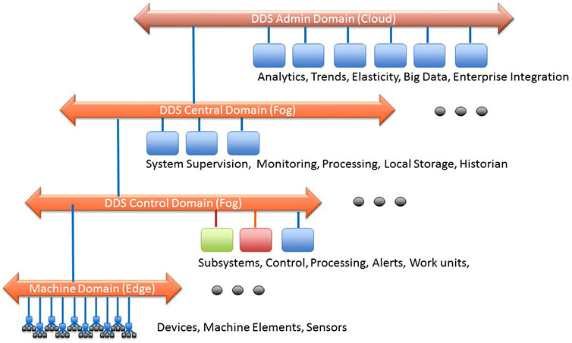
Properties of DDS
Quality of Service
Dynamic Discovery
Scalable Architecture
Notes:
Quality of Service
The data can also be shared with flexible Quality of Service (QoS) specifications including reliability, system health (liveliness), and even security. In a real system, not every other end-point needs every item in your local store. DDS is smart about sending just what it needs. If messages don’t always reach their intended destinations, the middleware implements reliability where needed. When systems change, the middleware dynamically figures out where to send which data, and intelligently informs participants of the changes. If the total data size is huge, DDS intelligently filters and sends only the data each end-point really needs. When updates need to be fast, DDS sends multicast messages to update many remote applications at once. As data formats evolve, DDS keeps track of the versions used by various parts of the system and automatically translates. For security-critical applications, DDS controls access, enforces data flow paths, and encrypts data on-the-fly.
The true power of DDS emerges when you specify all of these things simultaneously, at extremely high speeds, and in a very dynamic, demanding, and unpredictable environment.
Dynamic Discover
DDS provides Dynamic Discovery of publishers and subscribers. Dynamic Discovery makes your DDS applications extensible. This means the application does not have to know or configure the endpoints for communications because they are automatically discovered by DDS. This can be completed at runtime and not necessarily at design or compile time, enabling real “plug-and-play” for DDS applications.
This dynamic discovery goes even further than discovering endpoints. DDS will discover if the endpoint is publishing data, subscribing to data, or both. It will discover the type of data being published or subscribed to. It will also discover the publisher’s offered communication characteristics and the subscriber’s requested communications characteristics. All of these attributes are taken into consideration during the dynamic discovery and matching of DDS participants.
DDS participants can be on the same machine or across a network: the application uses the same DDS API for communications. Because there is no need to know or configure IP addresses, or take into account the differences in machine architectures, adding an additional communication participant on any operating system or hardware platform becomes an easy, almost trivial, task.
Scalable Architecture
The OMG DDS architecture is designed to be scalable from small devices to the cloud and for very large systems.DDS enables the Internet of Things by scaling across thousands or millions of participants, delivering data at ultra-high speed, managing many thousands of data objects, and providing extreme availability and security. DDS simplifies distributed systems development by absorbing much of the complexity in a single, standard communications layer.
For further information on the DDS standard then please visit the specifications page.

Slide 12
DDS: Functional Summary
Core Standard Criterion | Protocol Checklist
Provide syntactic interoperability | √
Open standard with strong independent, international governance | √
Horizontal in its applicability across industries | √
Stable and deployed across multiple vertical industries | Military, Software Integration
Have standards-defined Core Gateways to all other core connectivity standards | Web Services, OPC-UA
Meets connectivity functional requirements | √
Meet non-functional requirements of performance, scalability, reliability, resilience | √
Meet security and safety requirements | √
Not require any single component from any single vendor | √
Have readily-available SDKs both commercial and open source | √
DDS has been applied in multiple verticals to realize higher domain-specific interoperablity
open architecture specifications. These include:
• SGIP OpenFMB v1.0 (uses CIM extensions over DDS) - NAESB Standard
• MDPnP OpenICE Integrated Clinical Environment for Medical Device
Interoperability
• ROS: Robot Operating System (Open Source)
• EUROCAE ED-133 flight data exchange between air traffic control centers
• Generic Vehicle Architecture (GVA)
• Future Airborne Capability Environment (FACE)
• Open Mission Systems (OMS)
• Open Architecture Radar Interface Standard (OARIS)
• Unmanned Aircraft Systems Control Segment (UCS)
• Joint Architecture for Unmanned Systems (JAUS) over DDS
• Layered Simulation Architecture
• Navy Open Architecture

Slide 13
What is OPC-UA?
OPC UA is a protocol for industrial communication and has been standardized in the IEC 62541 series. At its core, OPC UA defines:
an asynchronous protocol (built upon TCP, HTTP or SOAP) that defines the exchange of messages via sessions, (on top of) secure communication channels, (on top of) raw connections,
a type system for protocol messages with a binary and XML-based encoding scheme,
a meta-model for information modeling, that combines object-orientation with semantic triple-relations, and
a set of 37 standard services to interact with server-side information models. The signature of each service is defined as a request and response message in the protocol type system.
The standard itself can be purchased from IEC or downloaded for free on the website of the OPC Foundation at https://opcfoundation.org/.

Slide 14
Secure client/server communications
XML Web Services
SOAP/HTTPS with UA Binary
Native Binary
UA XML
UA Binary
Authentication
Authorization
Encryption
Data integrity
WebServices Secure Conversation
UA Secure Conversation
SOAP
OPC TCP
TCP/IP
HTTPS
Protocol Stack diagram: GFDL-self/cc-by-sa3.0 https://de.wikipedia.org/wiki/Datei:Uaprotocols.png
Notes:
Message format: UA XML, UA Binary
Transport: OPC TCP, SOAP/HTTP(S)
Channel Security: None, Signed, Signed and Encrypted
Authenthication, Authorization, Encryption and Data integrity are performed by signatures.
SOAP w/ binary is a firewall-friendly variant with efficient coding.

Slide 15
Resilient communications
Redundancy
  OPC UA client and server high-availability
  Client: Active/Active
  Server: Passive/Active
Bidirectional “heartbeat”
  OPC UA clients and servers detect connection failures
Buffering
  OPC UA clients detect missing data and may request again
Notes:
Client redundancy: the server simply sees two clients. But the clients are talking to each other.
Server redundancy: client sends commands to both servers, but only the active one processes it.

Slide 16
Sophisticated interactions
I need to drill this plate
Are you able to drill materials?
Yes, which one?
Steel
Fine, which diameter?
1 inch (2.54 cm)
Fine, please provide coordinates and depth
X: 10, Y: 5, Z: 1
Fine, I am available now
I am sending you the plate
Ok, waiting for it

Slide 17
Open62541 Features
Communication Stack
model – Support for all OPC UA node types (including method nodes) – Support for adding and reOPC UA binary protocol
Chunking (splitting of large messages)
Exchangeable network layer (plugin) for using custom networking APIs (e.g. on embedded targets)
Information model
Support for all OPC UA node types (including method nodes)
Support for adding and removing nodes and references also at runtime.
Support for inheritance and instantiation of object- and variable-types (custom constructor/destructor, instantiation of child nodes)
Subscriptions
Support for subscriptions/monitor items for data change notifications
Very low resource consumption for each monitored value (event-based server architecture)
Code-Generation
Support for generating data types from standard XML definitions
Support for generating server-side information models (nodesets) from standard XML definitions

Slide 18
MQTT - message queue telemetry transport
Network decoupling: publisher and subscriber do not need to know each other IP address
Time decoupling: Publisher and subscriber do not need to run at the same time.
Synchronization decoupling: pub/sub is non-blocking.
Pub/Sub provides a greater scalability than the traditional client-server approach because its operations can be highly parallelized and event-driven.
Publisher (Source)
MQTT Broker
Subscriber (Sink)
sub(topic)
pub(topic, data)
pub(topic, data)
18

Slide 19
Example RESTFUL HTTP API
Addressable Resources
Constraint Interface
Resources may be consumed in multiple formats (JSON, XML, etc..)
All stateful information is held on the client side.
HTTP Verb | URI Path | Purpose
GET | /lcd/text/ | Returns the current text on the LCD screen
POST | /lcd/text/ json: {value:”Hello World”} | Sets the text on the LCD
DELETE | /lcd/text/ | Clear Texts
GET | /lcd/backlight/ | Returns the current state of the LCD backlight
POST | /lcd/backlight/ json:{r:255, b:0, g:0} | Sets the backlight to rgb(255,0,0) or RED
DELETE | /lcd/backlight/ | Turns the backlight off

